Slide 1


Slide 2
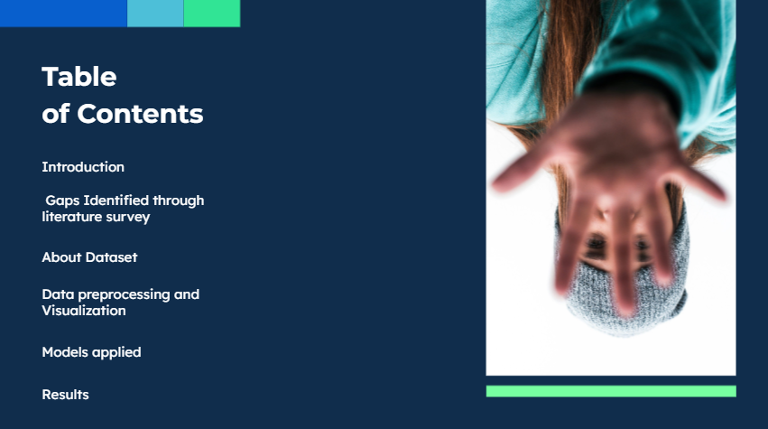

Slide 3
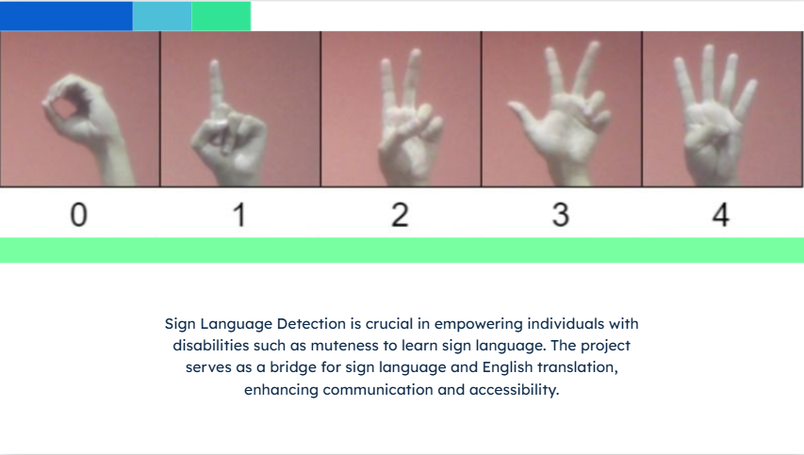
Sign Language Detection is crucial in empowering individuals with disabilities such as muteness to learn sign language. This project serves as a bridge for helping individuals with such disabilities to effectively learn sign language through the means of an app.

Slide 4
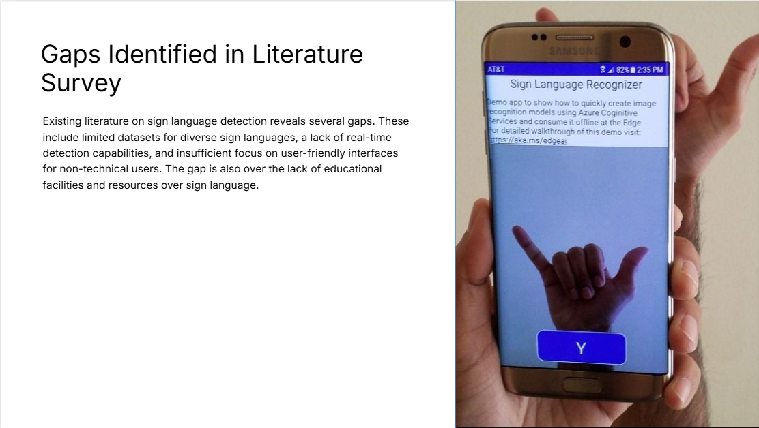

Slide 5
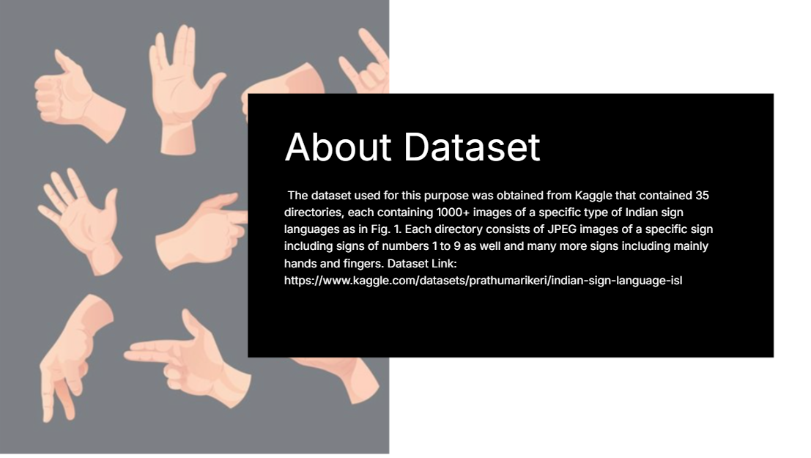
The dataset used for this purpose was obtained from Zenodo, named “INCLUDE – ISL” which consists of 46 directories covering different types of categories of signs like greetings, adjectives, clothes etc.
Each of these directories consists of several sub directories, that corresponds to a specific category of sign, and contains several videos with the format “MOV” of that sign.
In this implementation, we focused over predicting the adjective – signs initially which shifted to predicting greetings.

Slide 6
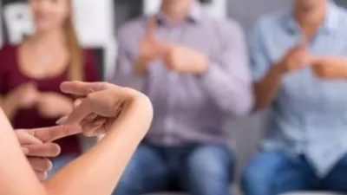



SDGs
The app would contribute to providing inclusive and equitable quality education by offering resources to teach sign language, making education accessible to people with hearing impairments and promoting lifelong learning opportunities for all.
The app would help reduce inequalities by providing the deaf and hard-of-hearing community with tools to communicate more effectively and integrate into mainstream society. It promotes inclusivity and accessibility in communication, reducing the social and cultural barriers faced by people with disabilities.
By promoting accessibility and communication, the app contributes to building more inclusive societies. It supports the right of people with hearing disabilities to participate in public life, access services, and engage in their communities.

Slide 7
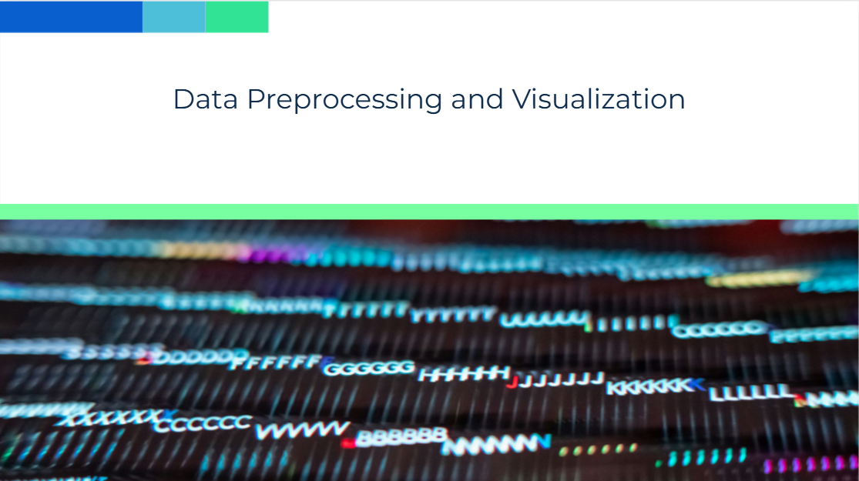
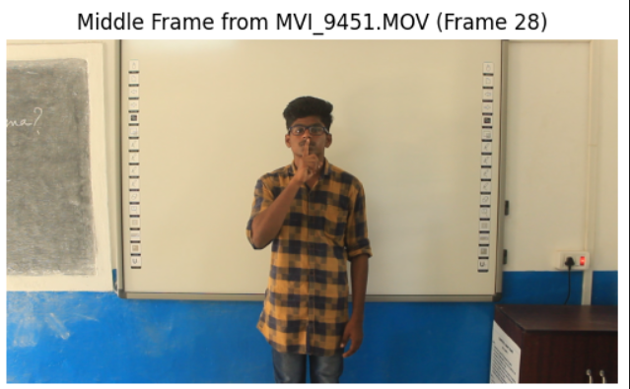
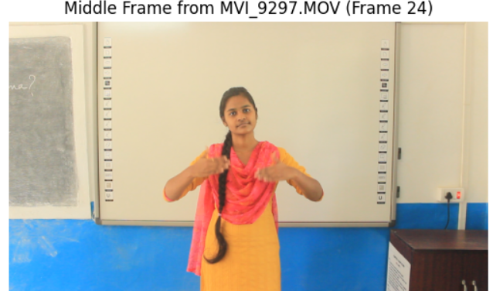
Video Frame Extraction:
Video frames were converted from BGR to RGB format using OpenCV method (cv2.cvtColor).
MediaPipe Pose model was used to extract pose landmarks from each frame.
Landmark Detection:
3D coordinates (x, y, z) were extracted for each body part where landmarks were detected.
Organizing Data:
The extracted pose landmarks was stored in a structured format (NumPy array).
Corresponding labels (e.g., activity type or sign name) were assigned to the data.
The processed datasets (pose_landmarks.npy and pose_labels.npy) were saved for efficient reloading and reuse.
Label Distribution
The occurrences of labels throughout the data was visualized and they were found to be unequal (“Good Morning”:1400,”Alright”:1417,”Good Afternoon”:1485,”How Are You”: 1676, “Hello”:1300).
Managing Landmarks
The shape of landmarks were visualized and fixed the inconsistency by padding or truncating.
Normalization:
The data was normalized using StandardScaler() for preventing features from disproportionately influencing the results.

Slide 8
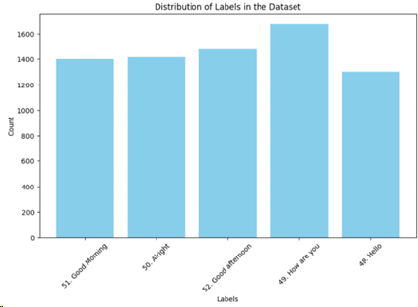
Resampling
The minority classes were oversampled using SMOTE (Synthetic Minority Over-sampling Technique).
Encoding
Label encoder was used to encode the string data (“hello”, ”good morning”, etc.) into numerical entities.
Data Splitting:
Dataset was split into training (80%) and validation (20%).
Tensor Conversion:
Data was converted into tensors for batch processing during training and evaluation.
Batch Preparation:
DataLoader was used to create mini-batches for efficient model training and avoid memory overload.
Frame Visualization:
middle frames from each video was displayed to check data consistency.

Slide 9
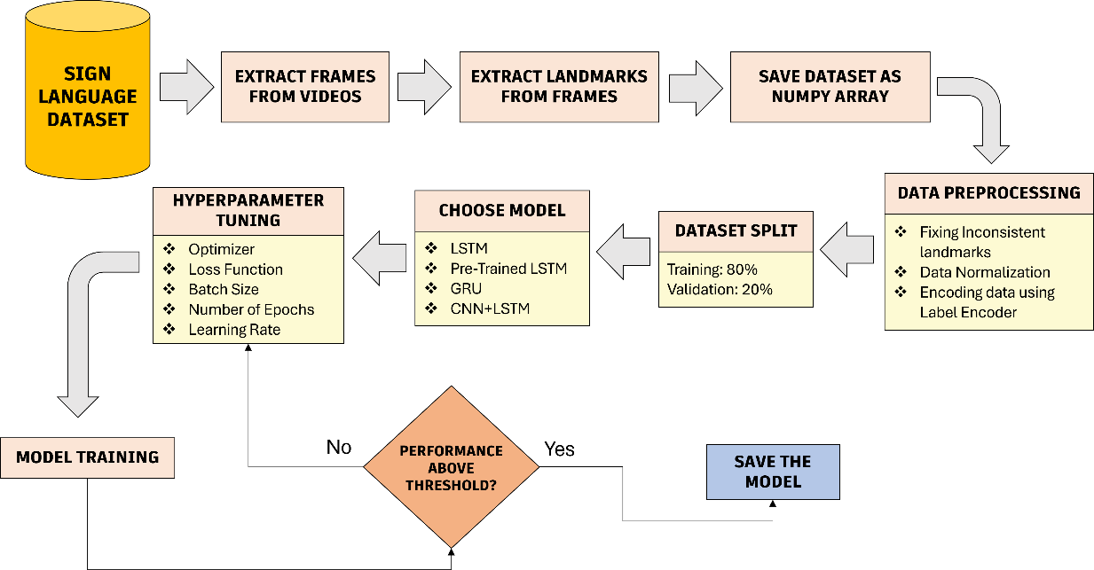
Methodology

Slide 10
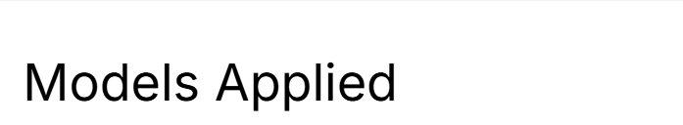
Models considered
LSTM (using PyTorch and TensorFlow), Pre-trained LSTM (MobileNetV2), GRU, CNN+LSTM.
Hyperparameters
A learning rate of 0.005 while training LSTM model built using PyTorch, and a learning rate of 0.001 while training LSTM, pretrained LSTM, GRU was considered. Additionally, batch size of 32 was taken for training the models except for one of the LSTM model, in which a batch size of 64 was taken.
Optimizer and Criterion
The optimizer Adam was used while working with each model.
The loss function of CrossEntropyLoss was considered for LSTM built using PyTorch, while the sparse_categorical_crossentropy loss function was used while working with the LSTM, pretrained LSTM, GRU built using TensorFlow.
LSTM model 1
The LSTM model 1 which was built using PyTorch consisted of three LSTM layers with different sizes, the first layer had 64 neurons, second one had 32 and third one had 16.
Batch first was set to be true, and a dropout of 0.4 was applied to each layer to reduce overfitting.
The data inputted was passed through the LSTM layers, and the output of each layer was stored for each time step.
After this, the output from the last LSTM layer was passed through the fully connected layer which mapped it to the number of classes, producing a tensor of shape.
LSTM model 2
This model was built using TensorFlow, and it consisted of three LSTM layers along with a time distributed layer.
The first and second layer consisted of 128 neurons, while the third consisted of 64.
return_sequences was set to true, so that it outputs the entire sequence instead of only the last time step.
Dropout of 0.4 was applied after each layer to reduce overfitting.
The Time Distributed Dense Layer had 64 neurons with activation function of RELU.
This layer applied a dense (fully connected) layer to each time step independently.
The final layer had 32 units, that only outputs the final time step’s output.

Slide 11
Pre-trained LSTM model
The pre-trained model of MobileNetV2 was loaded in this for extracting features, and its shape was set to 224x224 RGB image after which it was passed to additional layers.
The first layer had 128 neurons, second layer had 64 neurons.
A dropout of 0.4 was applied through the layers.
Fully connected layers performed the final classification.
GRU model
The first layer had 128 neurons, with return_sequences set as true, so as to output a sequence for each time step, allowing stacking of further recurrent layers.
The second layer had 128 neurons while third had 64.
There was also time distributed dense layer with 64 neurons and activation function of RELU which applied a fully connected layer to each time step independently.
The fourth layer had 32 neurons which was set to only output the final time step.
The final layer applied a `softmax` activation function, outputting probabilities for each class.
Dropout with a rate of 0.4 was applied throughout for regularization.
CNN+LSTM model
The model starts with a 1D Convolutional layer with 64 filters and a kernel size of 3, followed by a MaxPooling layer with a pool size of 2 for downsampling.
The second layer is a Bidirectional LSTM with 128 neurons, set to return sequences, allowing the model to capture both past and future dependencies.
An Attention layer is applied next, which computes the attention mechanism between the output of the LSTM and itself, helping the model focus on relevant parts of the sequence.
The output from the Attention layer is then passed through a Flatten layer, followed by a Dense layer with 64 neurons and a ReLU activation function.
The final layer is a Dense layer with neurons equal to the number of unique classes in the target, applying a `softmax` activation to output probabilities for each class.
The model starts with an initial learning rate of 0.001 (or whichever rate you set in the optimizer). During training, if the validation loss does not improve for 3 consecutive epochs, the learning rate is reduced by a factor of 0.5 (halved), until it reaches a minimum threshold of 1e-6. This adaptive learning rate adjustment is handled using the ReduceLROnPlateau callback.

Slide 12
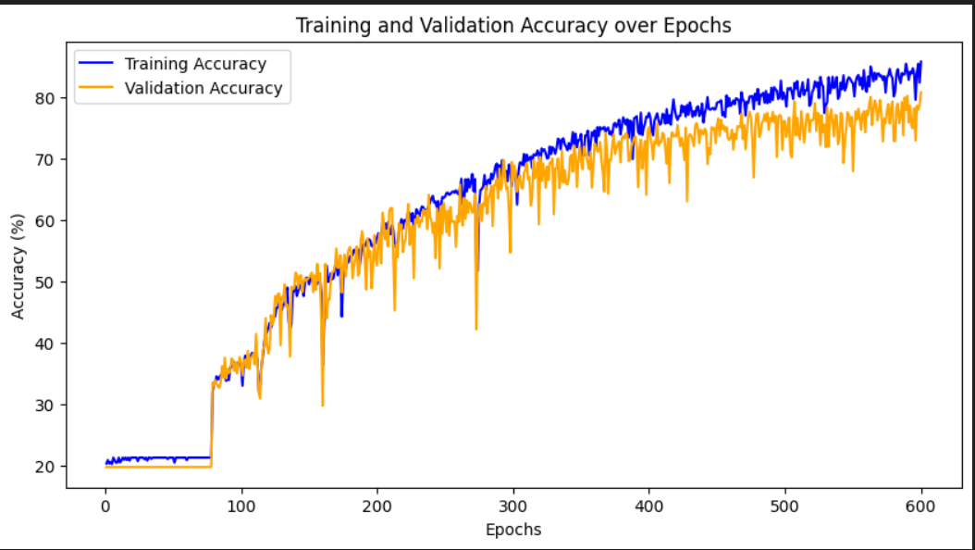
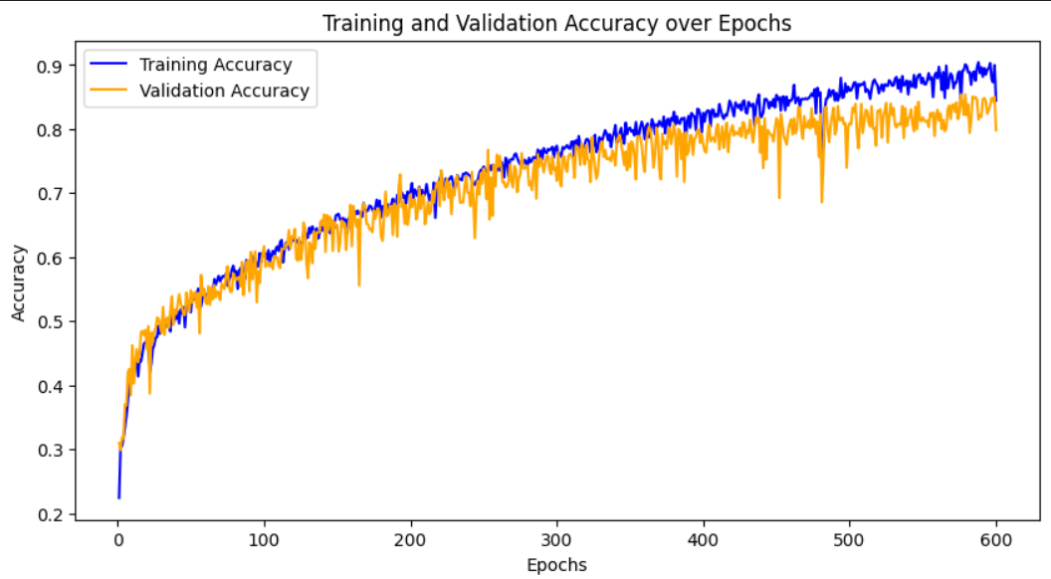
Results
LSTM Model 1
LSTM Model 2
LSTM model 1 gained a validation accuracy of 79.73% at 1200 epochs with a training accuracy of 84.68%
LSTM model 2 gained a validation accuracy of 85.82% at 1200 epochs with a training accuracy of 94.83%

Slide 13
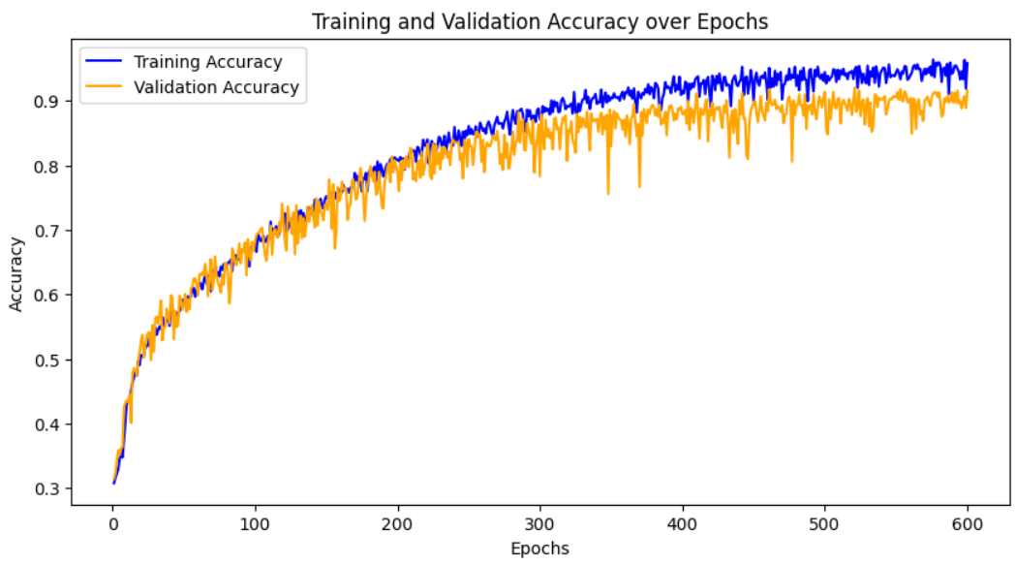
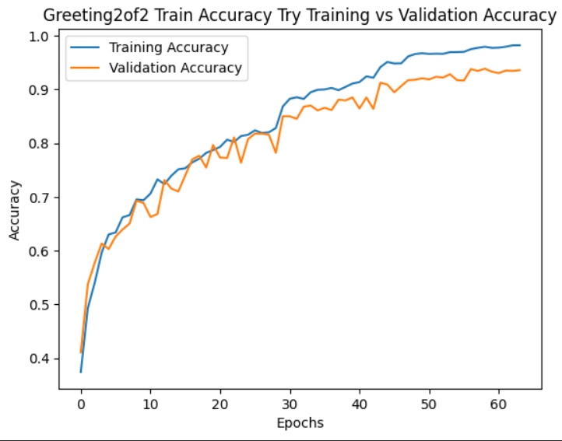
Results
GRU Model
CNN+LSTM Model
The pretrained model named MobileNetV2 gained a validation accuracy of 90.16% at 1200 epochs with a training accuracy of 96.35%
GRU model gained a validation accuracy of 91.66% at 600 epochs with a training accuracy of 96.19%
The CNN+LSTM model gained a validation accuracy of 93.61% at just 64 epochs with a training accuracy of 98.25%

Slide 14
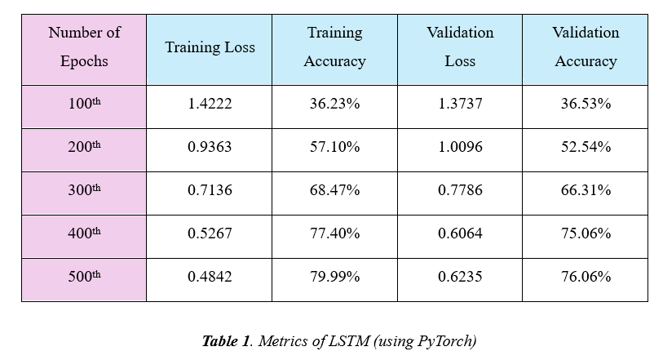
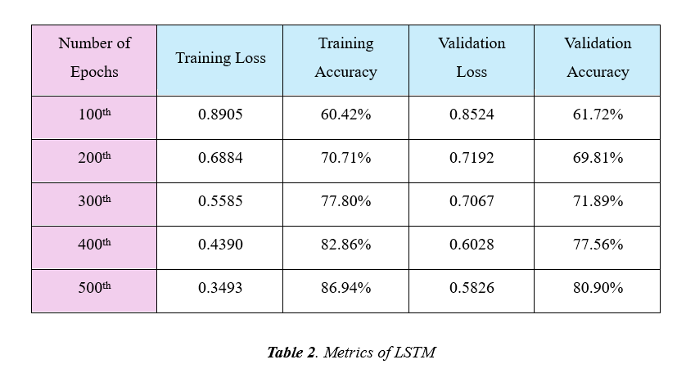
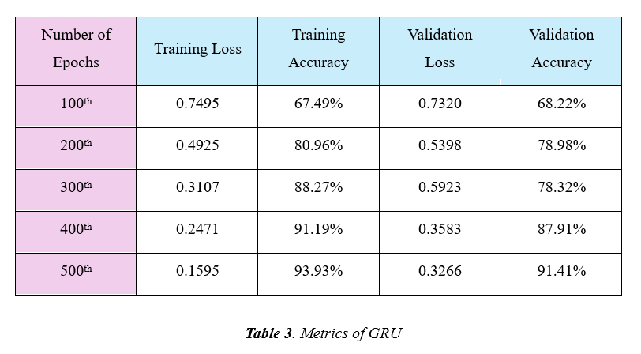
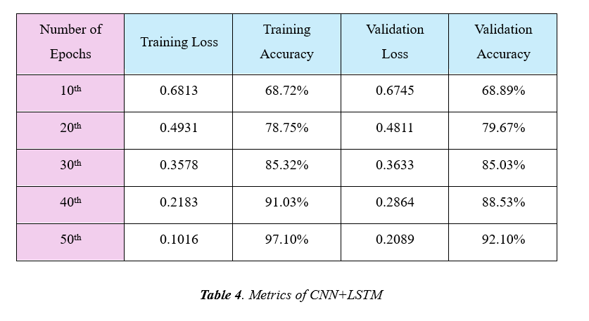
Results

Slide 15
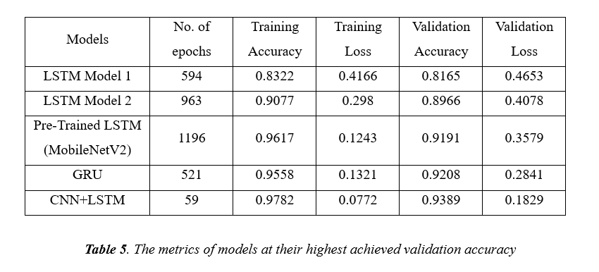
Results

Slide 16
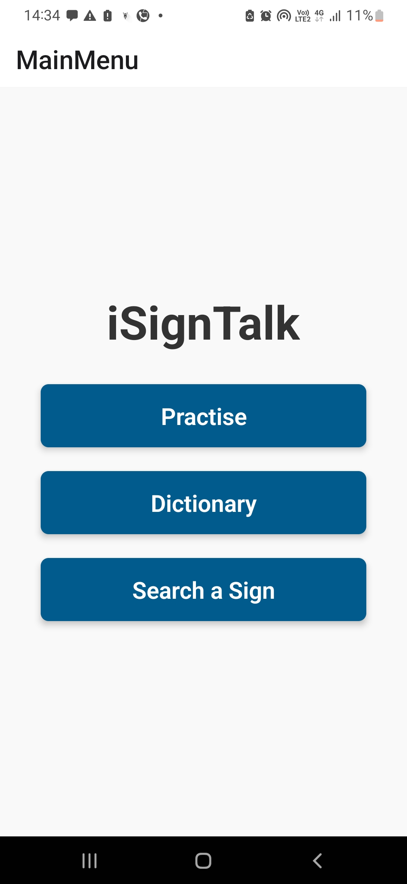
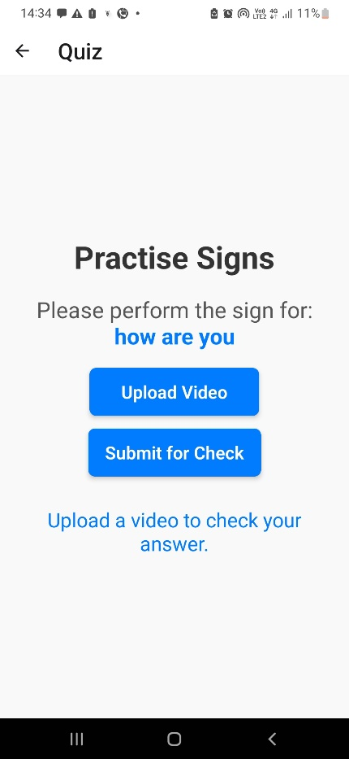
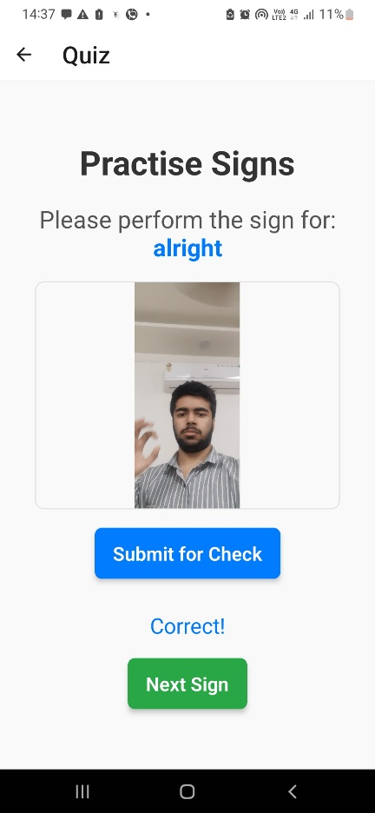
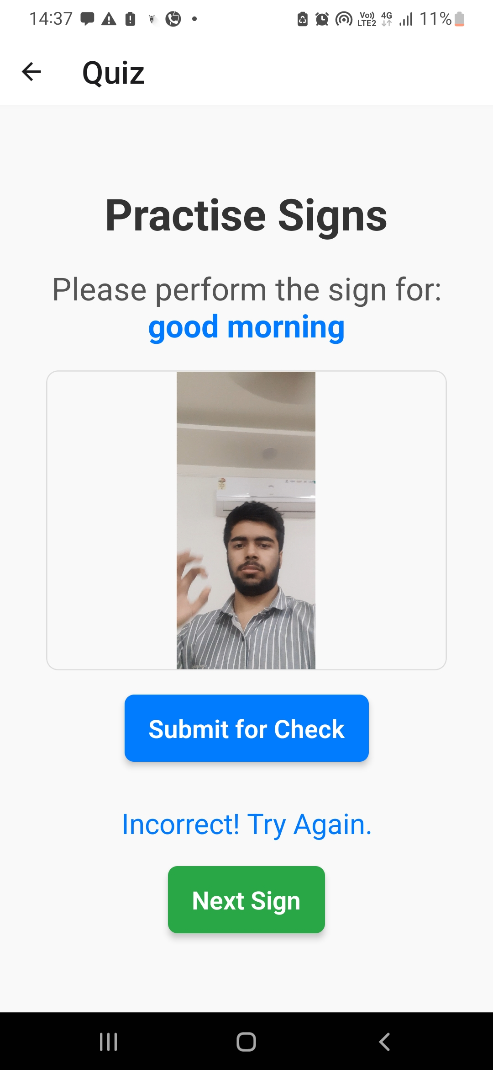
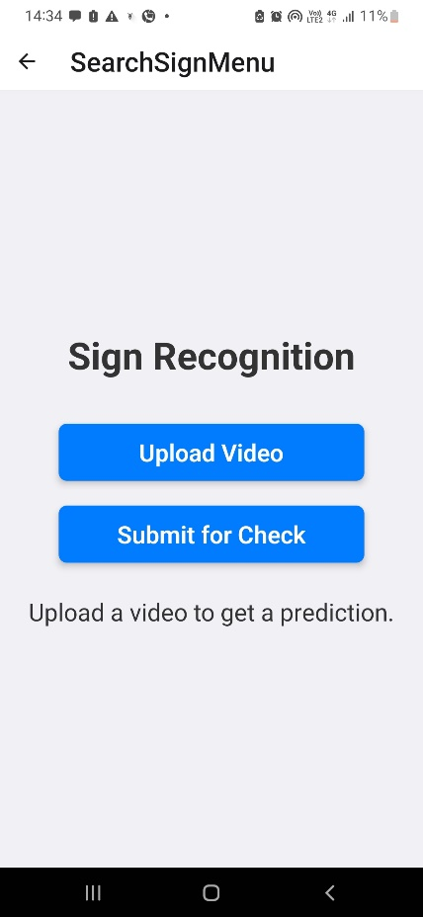
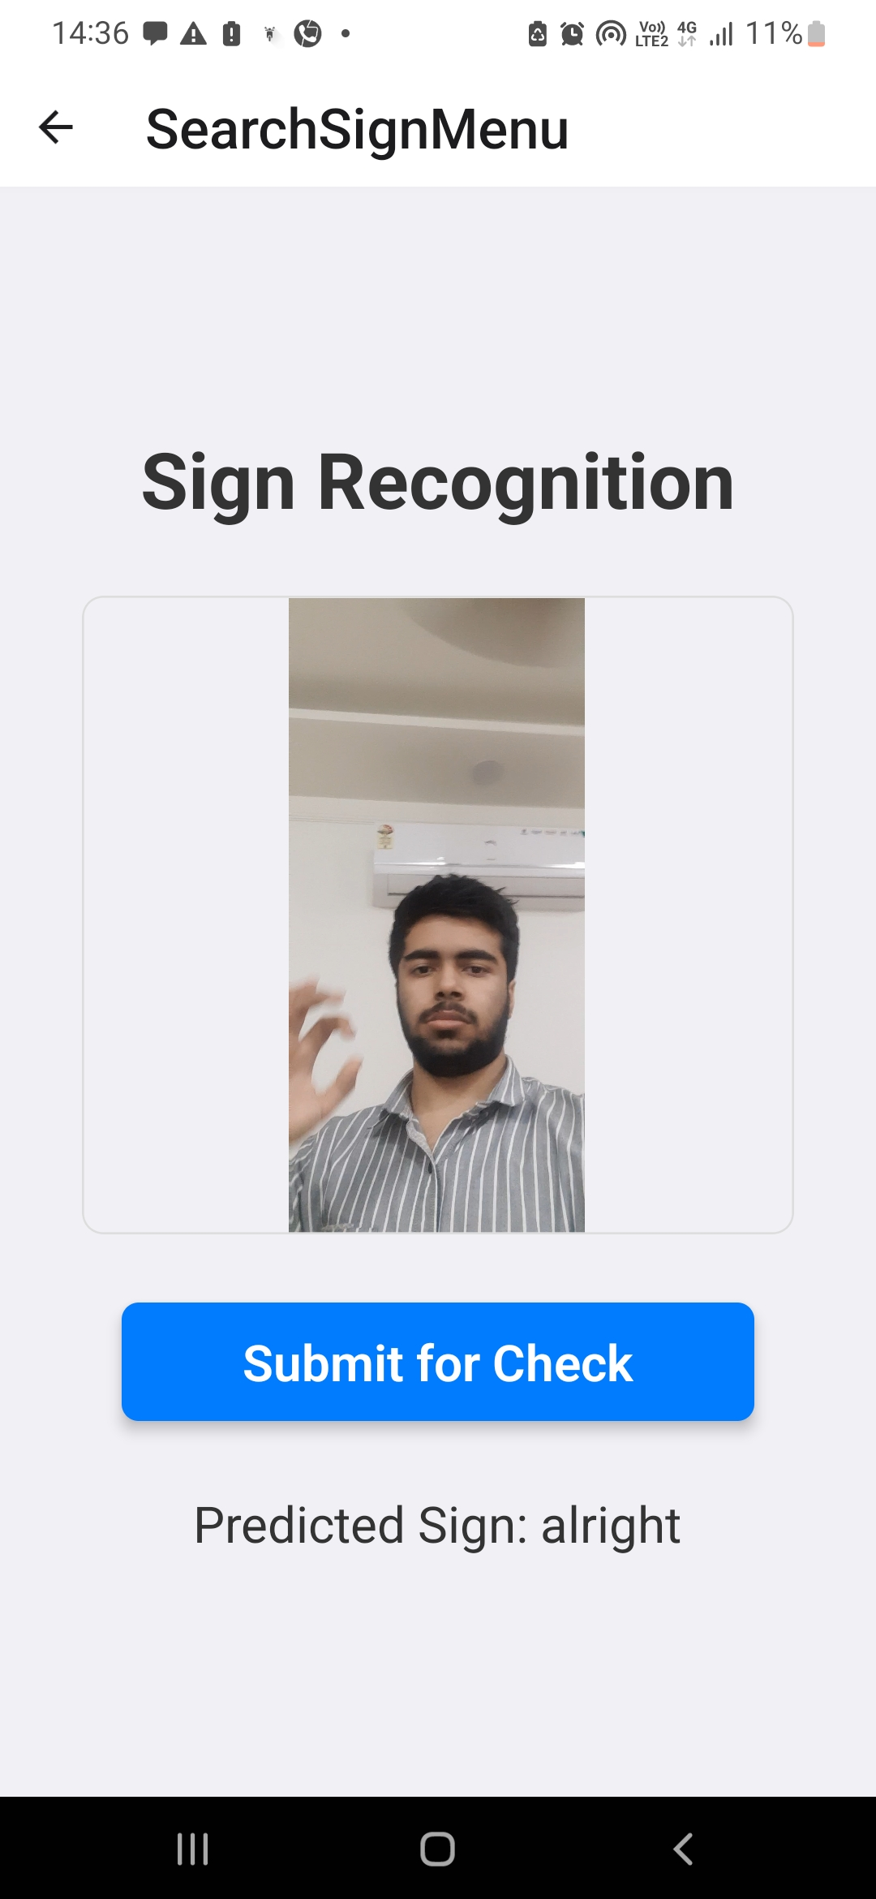
Outcome (App)
The App has 2 main modes:
Sign Prediction: User can upload a video and the sign that is performed in the video will be displayed.
Sign Challenge: User needs to upload a video that should include the given sign.

Slide 17
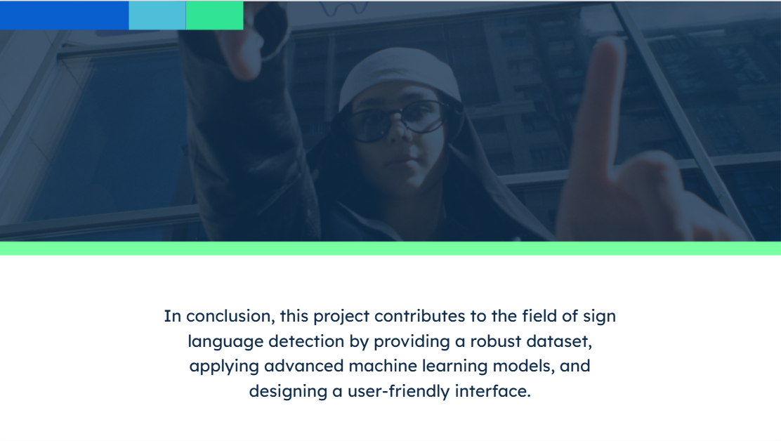
In conclusion, this project was successful in building the sign language learning app where in users can learn sign language.

